Slide 1
Case – Control Studies 1
Yasser Albogami, MPH, PhD
PHRM 414
September 2023

Slide 2
Learning objectives
Describe case-control studies and how they are used in pharmacoepidemiology
Discuss the relative advantages and disadvantages of the case-control study designs

Slide 3
Case-Control Studies
Analytical, usually retrospective study comparing:
  People with the disease (cases) to a sample of people without the disease (controls) with respect to exposures or characteristics of interest

Slide 4
Case-Control Studies
Aims to identify factors that could be responsible for the development of a disease or drug use problem
We don't calculate relative risk (RR) directly because the study design doesn't allow us to estimate the incidence rates of the outcome in the exposed and unexposed groups
  However, OR can be calculated, which in turn, usually approximate to the relative risk

Slide 5
Case-Control Studies
Motivation:
  Prospective cohort study may require long period of follow-up
  Rare disease
  Data may not exist for retrospective cohort study
Usually retrospective

Slide 6
Case-Control Studies
Backward Directionality
Exposure
Outcome/Disease
Time
Yes
?
No
?

Slide 7
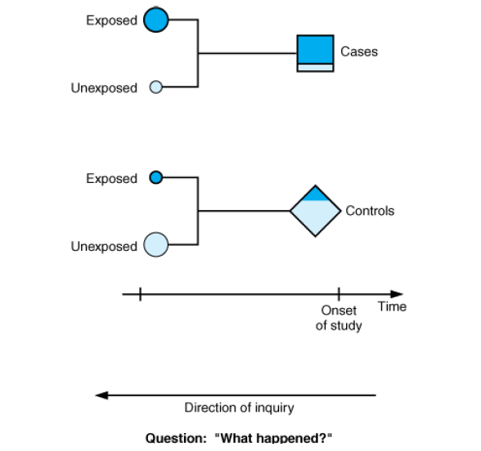
Case-Control Studies
Basic & Clinical Biostatistics: Chapter 2. Study Designs in Medical Research

Slide 8
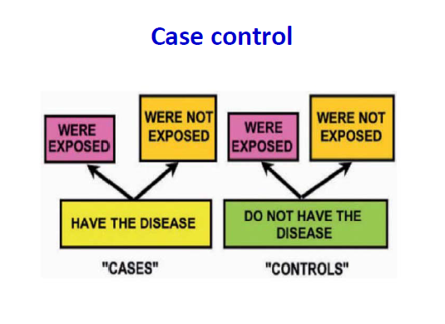
Case-Control Studies

Slide 9
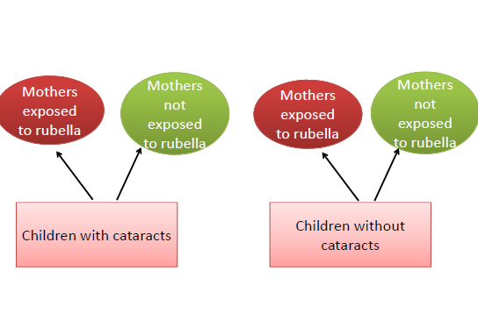
Case-Control Studies

Slide 10
Question
A case control study is a type of observational study is useful to look at factors associated with rare outcomes
T
F

Slide 11
Question
A case control study is a type of observational study is useful to look at factors associated with rare outcomes
T

Slide 12
Case-Control Studies
Much quicker and cheaper than prospective cohort study
Potential good starting point for scientific inquiry
Biggest challenge:
  Who to select as controls?

Slide 13
Basic Steps of Case-Control Studies
Formulation of the research questions
Identification and collection of cases
Selection of controls and matching
Determination of exposure in all subjects
Collection, analysis, and interpretation of data

Slide 14
Selection of Cases and Controls
Cases
  Have disease of interest
Controls
  Do not have disease of interest

Slide 15
Case Selection
Case definition: specifying criteria to identify a person as a case
  Diagnostic criteria
  Inclusion (eligibility)/ exclusion criteria
  Incident/prevalent
Cases source: define source population
  Registries
  Hospitals, medical facilities, physicians' office

Slide 16
Ideal Control Group
The purpose of controls is to measure the frequency of exposure in the source population that produced the cases
Cases
Asthma
Have used ibuprofen?
Controls: No asthma

Slide 17
Ideal Control Group
Probability of sampling any “exposed” person as a control should be proportional to the number of exposed people in the source population

Slide 18
Ideal Control Group
To achieve this ideal (these are equivalent):
Controls should be drawn from the source population that produced the cases
Controls much be sampled independently of their exposure status
Controls should be those who, had they in fact developed the outcome, would have ended up being sampled in your study as a case

Slide 19
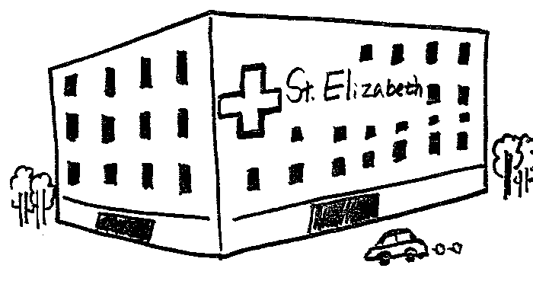
Good Selection of Controls
Cases:
or
?
Controls
Source Population:
50% used ibuprofen,
50% have not used ibuprofen

Slide 20
Sources of Control Group
Same community
Patients in the same hospital
Individuals who reside in the same neighborhood
Siblings, or associates of the cases

Slide 21
Sources of Controls: Hospitalized Patients
When cases are hospital-recruited, source population is the catchment population of the hospital
Catchment population: all the people who would have been identified as a case, had they in fact developed the disease
One approach is selecting controls who have a different illness and are treated at same hospital, sometimes called hospital, clinic, or diseased controls

Slide 22
Sources of Controls: Hospitalized Patients
Advantages:
Convenient and relatively inexpensive
Cases and controls are likely to be similar in their accuracy of recall
Generally high level of cooperation of subjects
Disadvantages: (both selection bias scenarios):
Disease for which controls are hospitalized may be associated with exposures under study
Selection factors leading to hospitalization may differ between cases and controls (referral patterns)

Slide 23
Basic Analysis Of Case Control Studies:
2x2 Tables
Data is expressed in a 2*2 table, and an odds ratio is calculated
 | Disease Status
Exposure Status | Positive | Negative
Exposed | a | b
Unexposed | c | d
Total exposed = a + b
Total unexposed = c + d
Total with disease = a + c
Total without disease = b + d

Slide 24
Odds
Exposure odds in those with disease
Probability=a/(a+c)
Odds
= [a/(a + c)] / [1 - [a/(a + c)] ]
= [a/(a + c)] / [c/(a + c)]
= a/c
Exposure odds in those without disease
Probability=b/(b + d)
Odds=[b/(b + d)] / [d/(b + d)]
= b/d
 | D+ | D-
E+ | a | b
E- | c | d

Slide 25
Odds Ratio
Odds that a case was exposed / the odds that a control was exposed
= (a/c) / (b/d)
= (a/c) * (d/b)
= ad / bc = cross-product
 | D+ | D-
E+ | a | b
E- | c | d

Slide 26
Interpretation of OR
“Benzodiazepine ever use was associated with an increased risk of Alzheimer's disease (adjusted odds ratio 1.51, 95% confidence interval 1.36 to 1.69)”
Interpretations
  AD is associated with a 1.51-times increase in the odds of Benzodiazepene use
  Benzodiazepene use is associated with a 1.51-times increase in the odds of AD

Slide 27
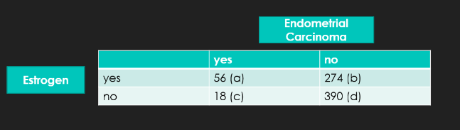
Question
In a study examining the association between estrogen (exposure) and endometrial carcinoma (outcome):
The OR = ?
What does that mean?
Notes:
individuals with endometrial cancer are 4.42 times more likely to be exposed to estrogen than those without endometrial carcinoma.

Slide 28
Question
Study Question:
Do OC’s increase the risk of myocardial infarction (MI)?
Cases: 500 women hospitalized for MI
Controls: 1,500 women hospitalized for non-heart related conditions.
Case to control ratio: 1 to 3
Notes:
individuals with endometrial cancer are 4.42 times more likely to be exposed to estrogen than those without endometrial carcinoma.

Slide 29
Question
 | OC Use? | First SELECT | on outcome
 |  | (O) Cases Hospitalized for MI | (Ō) Controls Non-Heart Hospitalization
E | Ever | 145 | 420
E | Never | 355 | 1080
 | Totals | 500 | 1500
Notes:
individuals with endometrial cancer are 4.42 times more likely to be exposed to estrogen than those without endometrial carcinoma.

Slide 30
Question
Used OCs | Cases-MI | Controls-Non MI
Ever | 145 (A) | 420 (B)
Never | 355 (C) | 1080 (D)
AD
BC
145 x 1080
420 x 355
ODDS RATIO =
=
= 1.05
Notes:
individuals with endometrial cancer are 4.42 times more likely to be exposed to estrogen than those without endometrial carcinoma.

Slide 31
Question
Results and Conclusions:
Prior use of OC’s appears to be associated with a slight increased risk of MI in these data.
Women who have used OC’s have 1.05 times the odds of MI compared to women who have never used OC’s.
Notes:
individuals with endometrial cancer are 4.42 times more likely to be exposed to estrogen than those without endometrial carcinoma.

Slide 32
Case-Control Studies- Example
CHD CHD
(+) (-)
Hypertension (cases) (controls)
Present 150 225
Absent 100 275
Total 250 500
Analysis:
% with hypertension 60% 45%
Issues of Concern:
Definition of CHD and use of incident vs prevalent cases
Definition and measurement of hypertension
Role of other potential confounders and issues of matching vs
regression modeling

Slide 33

Collecting Data in Case-Control Studies
Data must be collected on prior exposure to risk factor of interest
Information about a variety of exposures may be collected to look for associations with the disease or drug use
Source of Data:
  Interviews and questionnaires are the most common means of determining a subject's exposure history
  Medical records review
  Biological marker

Slide 34
Matching in Case-Control Studies
Purpose:
  Helps to ensure that cases and controls are similar with respect to important risk factors
  To control for confounding or selection bias
More than one control can be matched to each case, but the ratio of controls to cases rarely exceeds 4:1
Example: gender , age, bmi, etc…

Slide 35
Matching Cases and Controls
Pluses
Drawback
Increase the statistical efficiency of case-control comparisons
Simplifies decisions about how to sample controls
It ensures that case-control differences in the risk factor of interest cannot be explained by reference to the matched variables.
Time consuming
Potential cases and controls may be excluded because matches cannot be made
Matched variables cannot be evaluated as risk factors in the study population

Slide 36
Bias in Case-Control Studies
Confounding
Selection bias
Information bias
  Differential
  Non-differential

Slide 37
Case-Control Studies- How Good Are They?
Advantages:
Saves time and money
Efficient way to deal with long induction period
Ideal when outcome is rare
Allows evaluation of multiple exposures for single disease
Disadvantages:
Accurate data on exposure may be difficult to obtain
Inefficient with rare exposures
Greater potential for bias when disease status is known when assessing exposure status
Selection of controls

Slide 38
THANK YOU
Questions
yalbogami@ksu.edu.sa

